Slide 1
Algebra Revision
Year 8

Slide 2

Date
24
7
30
Solving Equations
EQ – How do I find an unknown value in an algebraic equation?
What is a variable and how do we solve equations involving them?
Examples
To solve an equation with a variable, we rearrange the equation so our unknown value is by itself on one side of the equals sign. If you do something on one side of the equals sign, do it on the other! We do this by doing the inverse action.
x + 2 = 4
Think: Inverse of + is -
x + 2 = 4
-2 -2
x = 2
CHECK YOUR ANSWER!!
2+2=4
x ÷ 3 = 4
Think: Inverse of ÷ is x
x ÷ 3 = 4
x3 x3
x = 12
CHECK YOUR ANSWER!!
12 ÷ 3 = 4
The inverse functions are:
+ -
+
x ÷
÷ x
If you do something on one side of the equals sign, do it on the other!

Slide 3
24
7
30
Solving Multi-step Equations
Date:
C type Questions
EQ – How to solve multi-step algebraic equations?
n + 4 = 9
5 + k = 14

Slide 4
24
7
30
Solving Two-Step Algebraic Equations
Date
EQ – What are the steps involved in solving two-step algebraic equations?
1) Undo the addition or subtraction operation first, by using inverse operations.
Solving Two-Step
Equations
2) Undo the multiplication or division operation second, by using inverse operations.

Slide 5
24
7
30
Solving Two-Step Algebraic Equations
Date
EQ – What are the steps involved in solving two-step algebraic equations?
Solve: 3x + 4 = 16
Solving Two-Step
Equations
3x + 4 = 16
-4 -4
Undo Addition or Subtraction 1st
3x = 12
3
3
Undo Multiplication or Division 2nd
x = 4

Slide 6
24
7
30
Solving Two-Step Algebraic Equations
Date
EQ – What are the steps involved in solving two-step algebraic equations?
1) GOAL:
Get the variable on one side of the equation.
To Review
2) You always perform the same operation to
both sides of an equation.
3) To undo an operation you perform its opposite operation to both sides of the equation.
4) It is easier if you undo addition or subtraction before you undo multiplication or division.

Slide 7
24
7
30
Solving Two-Step Algebraic Equations
Date
EQ – What are the steps involved in solving two-step algebraic equations?
Example 1
2x + 4 = 10
Get the variable alone.
- 4 - 4
2x = 6
__ __ 2 2
+4 and -4 cancel out
Divide both sides by 2
x = 3
2 divided by 2 cancel to 1
2(3) +4 = 10
Show your check.
6 + 4 = 10
10 = 10
Finish your check.

Slide 8
24
7
30
Solving Multi-step Equations
Date:
C type Questions
EQ – How to solve multi-step algebraic equations?
3n + 1 = 13
5k - 3 = 27
6a + 3 = 21

Slide 9
24
7
30
Solving Multi-step Equations
Date:
B/C type Questions
EQ – How to solve multi-step algebraic equations?
n + 3 = 5
2
c - 4 = 2
5
h + 9 = 12
7

Slide 10
24
7
30
Solving Multi-Step Algebraic Equations
Date
EQ – How do we solve more advanced multi-step equations?
REVIEW: Simplify Using the Distributive Property.
What happens when there are brackets?
Distributive Property – Multiply everything in the parentheses.
a (b + c ) =
ab + ac
OR a ( b – c ) =
ab – ac
Example 1: -3 ( x + 5 )
= -3x - 15
Example 2: -7 ( 2a – 4 )
= -14a + 28

Slide 11
24
7
30
Solving Multi-Step Algebraic Equations
Date
EQ – How do we solve more advanced multi-step equations?
REVIEW: Simplify Using Combining Like Terms
What happens when there are brackets?
Like Terms must have the same variables and the same powers on the letters.
Combine like terms by adding or subtracting the coefficients (numbers in front of the variables).
Example 1: 3x + 5 – 7x + 9
-4x
+ 14
Example 2: 3 – 6y – 7 – 9y
-4
– 15y

Slide 12
24
7
30
Solving Multi-Step Algebraic Equations
Date
EQ – How do we solve more advanced multi-step equations?
FIRST - Use the Distributive Property to get rid of the parentheses.
Example: 3 ( x – 2 ) + 4x = 8
SECOND: Combine like terms.
3x
– 6
+ 4x = 8
Copy the rest of the problem.
7x
– 6 = 8
+ 6 + 6
Add 6 to both sides.
Now it’s a regular 2-step equation.
7x = 14
Divide both sides by 7.
7 7
x = 2

Slide 13
24
7
30
Solving Multi-step Equations
Date:
B type Questions
EQ – How to solve multi-step algebraic equations?
2(3f – 1) = 21
2(4 -2s) = 22
7(2 -3w) = 56

Slide 14
24
7
30
Solving Multi-Step Algebraic Equations
Date
EQ – How do we solve more advanced multi-step equations cont…?
Variables on both sides
+ 2x + 2x
9 = 6x – 15
+ 15 + 15
24 = 6x
6 6
4 = x
Example: – 2x + 9 = 4x – 15
Move the variables to one side by adding 2x to both sides
Now solve like a regular two-step equation
Don’t forget to check
your work:
– 2(4) + 9 = 4(4) – 15
– 8 + 9 = 16 – 15
1 = 1

Slide 15
24
7
30
Solving Multi-step Equations
Date:
A type Questions
EQ – How to solve multi-step algebraic equations?
f + 13 = 1 + 5f
3t – 2 = 5t - 10
4w + 3 = 10w - 21

Slide 16
24
7
30
Solving Multi-step Equations
Date:
A type Questions
EQ – How to solve multi-step algebraic equations?
4(2a - 1) = 3(a + 2)
6(c - 5) = 5(c - 4)

Slide 17
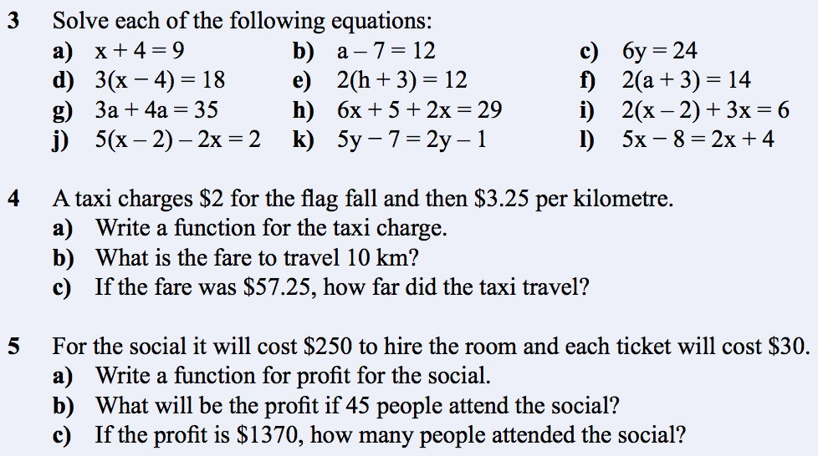
Your turn

